Slide 1

Computational Neuroscience
Assignment (1)
By: Momen Tarek Gaber
4221022

Slide 2

Contents
1
✔ Forward propagation
2
✔ Tanh activation function
3
✔ Given weights and biases
4
✔ Visualization using Matplotlib

Slide 3

Steps to Implement
Define the tanh activation function
Store weights and biases as given in the image
Perform forward propagation
Visualize the network using networkx and matplotlib

Slide 4

🖥 How It Works:
1️eEnter values for b1 and b2 in the GUI
3️It calculates hidden & output layers using the tanh function
2️Click "Calculate Neural Network"
4️ Results are displayed, and the neural network is visualized

Slide 5


What Happens?
✅ Neurons activate dynamically
✅ Edges light up in sequence
✅ Weight values appear clearly
✅ A smooth, clean animation effect

Slide 6
without laibarary >>>

Slide 7
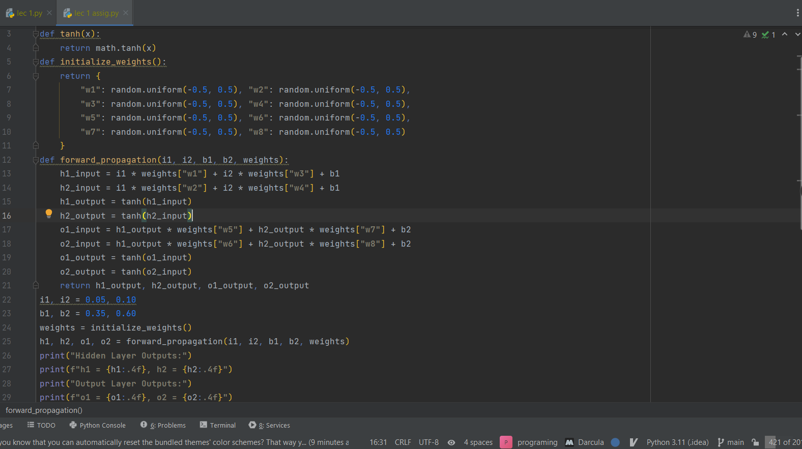

Slide 8
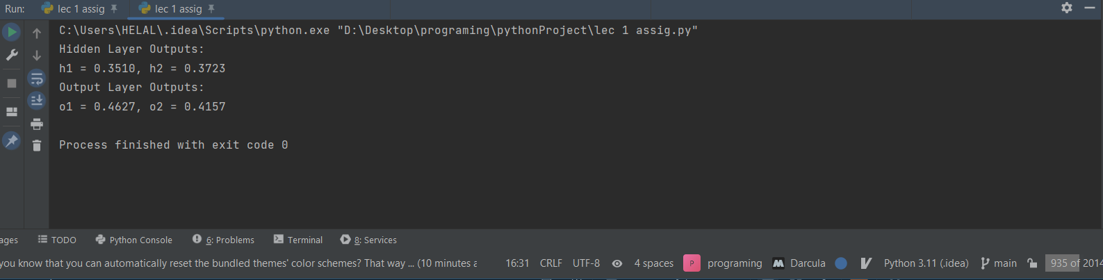

Slide 9
by laibarary >>>

Slide 10
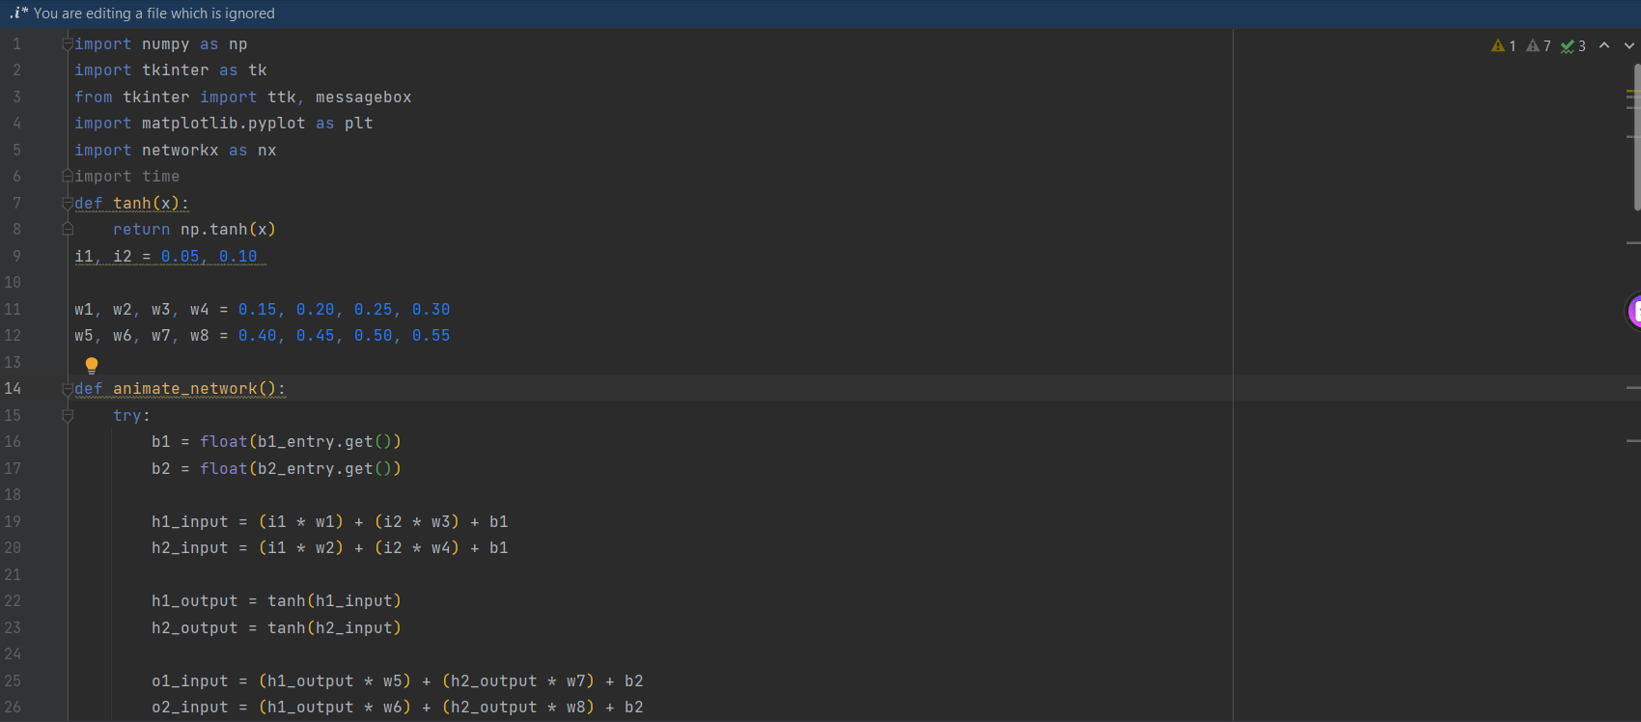
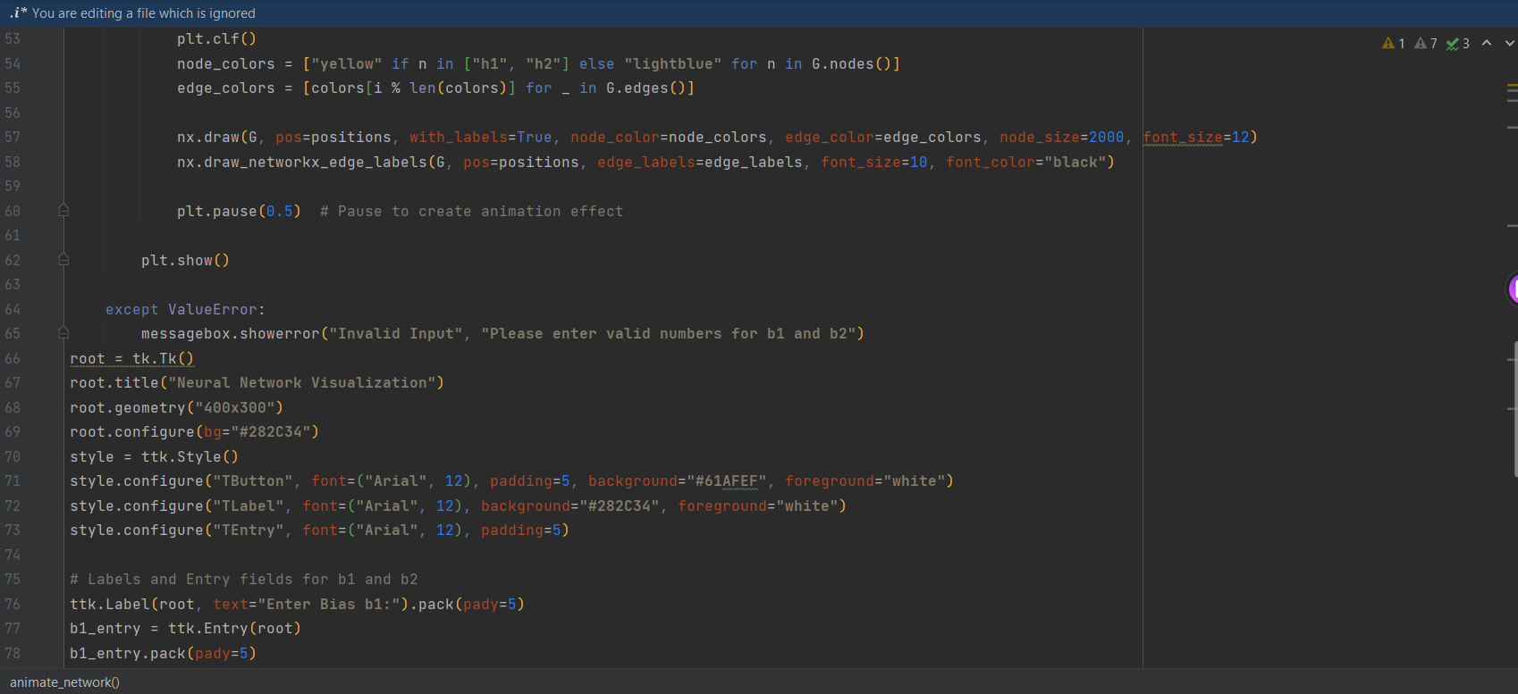
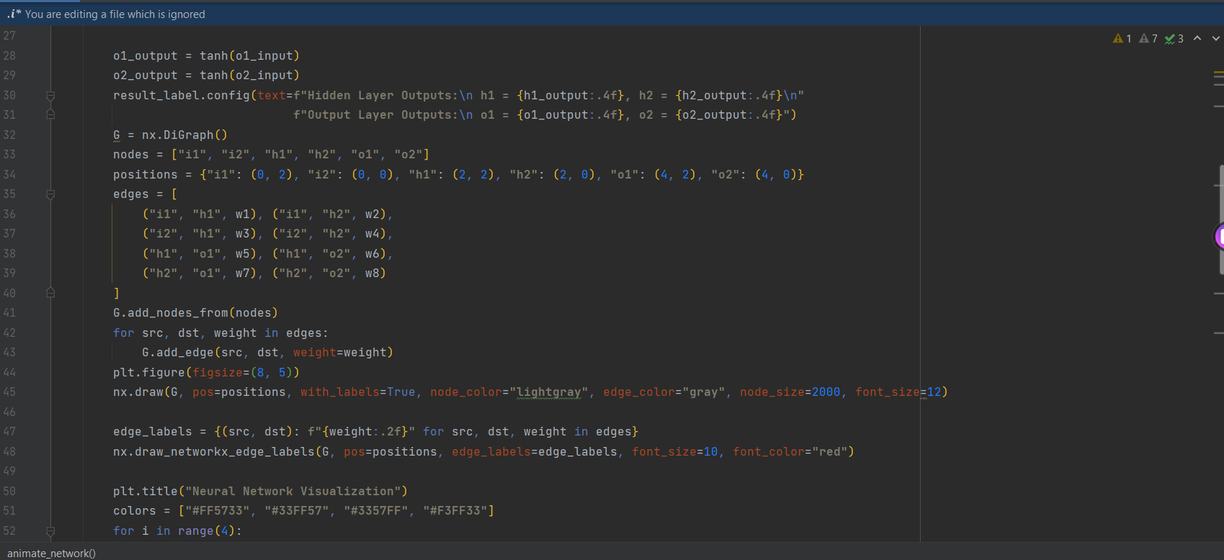
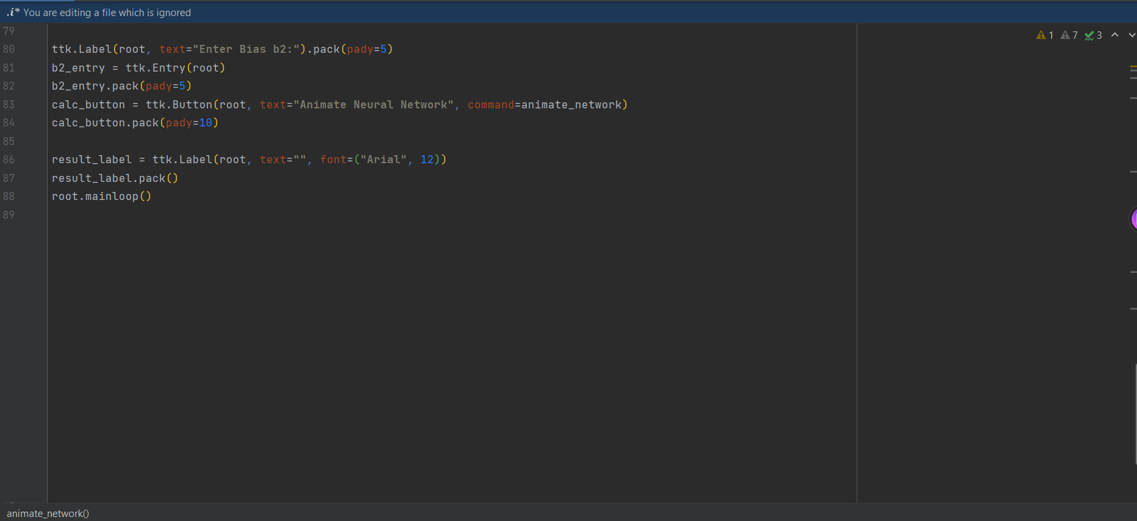

Slide 11
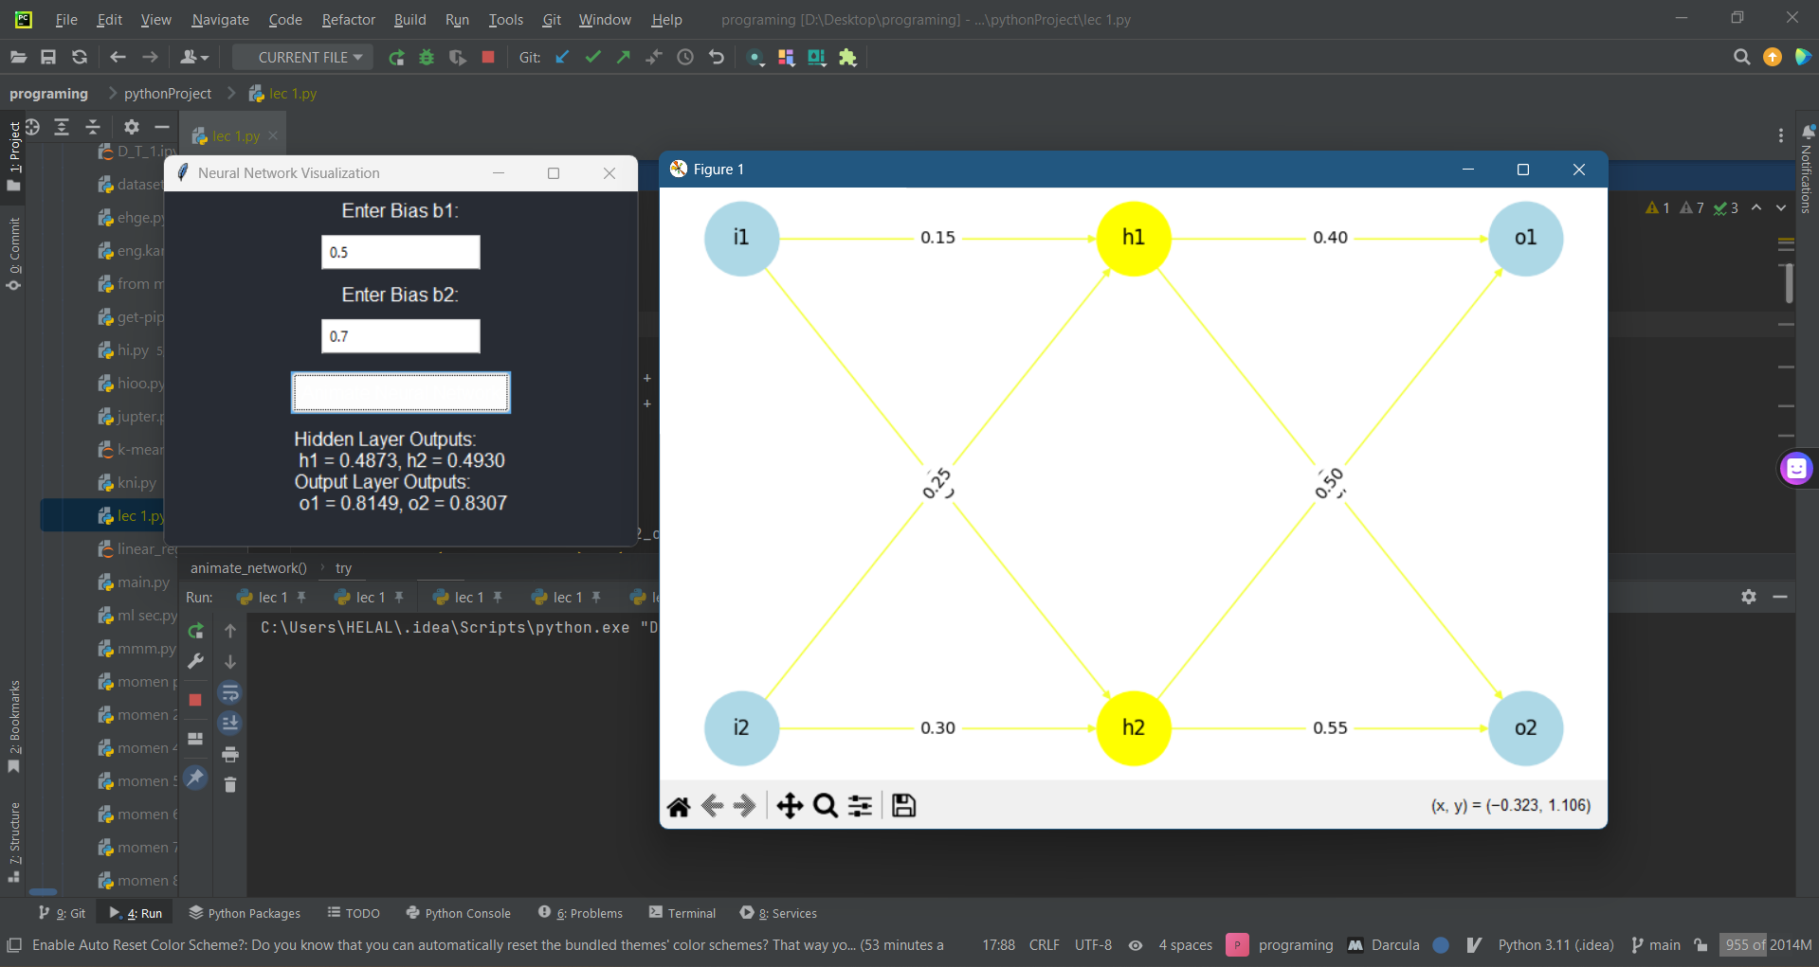

Slide 12
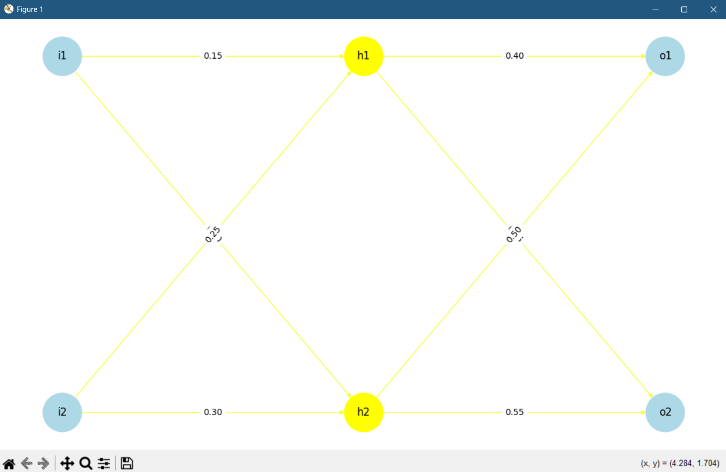
(Neural Network Visualization with Activation)
A graphical representation of a feed forward neural network with two input neurons (i1, i2), two hidden layer neurons (h1, h2), and two output neurons (o1, o2).
Color Representation:
Yellow nodes indicate neurons that are currently active (highlighted based on computed values).
Blue nodes represent input and output neurons.
Yellow edges signify active connections with weights.

Slide 13
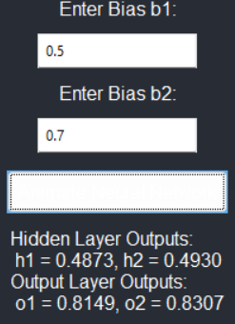
(GUI for Bias Input and Output Display)
This is a graphical user interface (GUI) where the user can enter values for biases b1 and b2.
Two input fields allow the user to enter the values for b1 and b2.
Below the inputs, a button labeled "Animate Neural Network" is present, which likely triggers an animation of the neural network's operations.
The output section displays:
Hidden Layer Outputs: Values of hidden neurons
h1 and h2 after applying the activation function.
Output Layer Outputs: Values of output neurons o1 and o2.

Slide 14

THANK YOU FOR LISTENING!
https://github.com/ELMOtarek1/Computational-Neuroscience

